Slide 1
Credit EDA Case Study
Ashutosh Nayak
Mahesh PRASAD Mishra

Slide 2
Introduction
This case study aims to give you an idea of applying EDA in a real business scenario. In this case study, apart from applying the techniques that you have learnt in the EDA module, you will also develop a basic understanding of risk analytics in banking and financial services and understand how data is used to minimise the risk of losing money while lending to customers.

Slide 3
Business Understanding
The loan providing companies find it hard to give loans to the people due to their insufficient or non-existent credit history. Because of that, some consumers use it as their advantage by becoming a defaulter. Suppose you work for a consumer finance company which specialises in lending various types of loans to urban customers. You have to use EDA to analyse the patterns present in the data. This will ensure that the applicants are capable of repaying the loan are not rejected.

Slide 4
Business Objectives
This case study aims to identify patterns which indicate if a client has difficulty paying their instalments which may be used for taking actions such as denying the loan, reducing the amount of loan, lending (to risky applicants) at a higher interest rate, etc. This will ensure that the consumers capable of repaying the loan are not rejected. Identification of such applicants using EDA is the aim of this case study.

Slide 5
Solution Approach
We have followed following EDA approach for this solution.
Data Understanding :
Sampling of data to find out data definitions.
Analyze the data types of each of the columns and if needed try to modify the data types suitable for our analysis.
Try to understand the all the columns that are available and try to indentify the variables for our univariate and bivariate analysis.
Data Cleaning :
As mentioned in the requirement we have removed the columns which has null value percentage more than 45% and we have umpute the variables with zero which has null value more than 14% and again the variables which has less than 14% null value we have imputed with median for numerical variable.
For categorical variables the null value should be imputed with mode value of the respective column but we did not find any null value in the categorical variable.

Slide 6
Solution Approach
Data Cleaning :
We have found out the outliers for some of the numeric columns and imputed with median value for the outliers.
We have filtered out the data based on the target variables and have analyzed the data for data imbalance.
Data Analysis:
We have identify continuous variables and categorical variables for each Target category for univariate analysis.
For each Target variables we have done Bivariate analysis for continuous-continuous variables and continuous-categorical variables.
Find the Correlation between all these variables to find out clients with payment difficulties
Using different visualization technique present the analysis.

Slide 7
Data understanding
Sampling of data to find out data definitions
Understanding the various Features of data

Slide 8
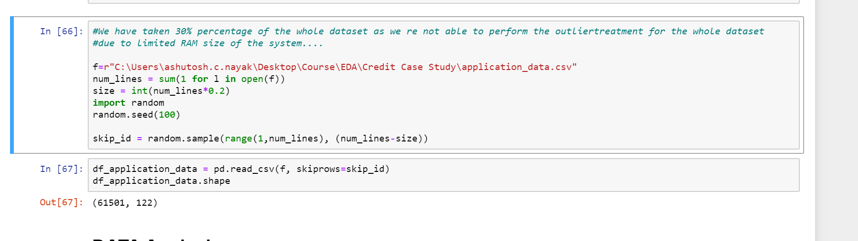
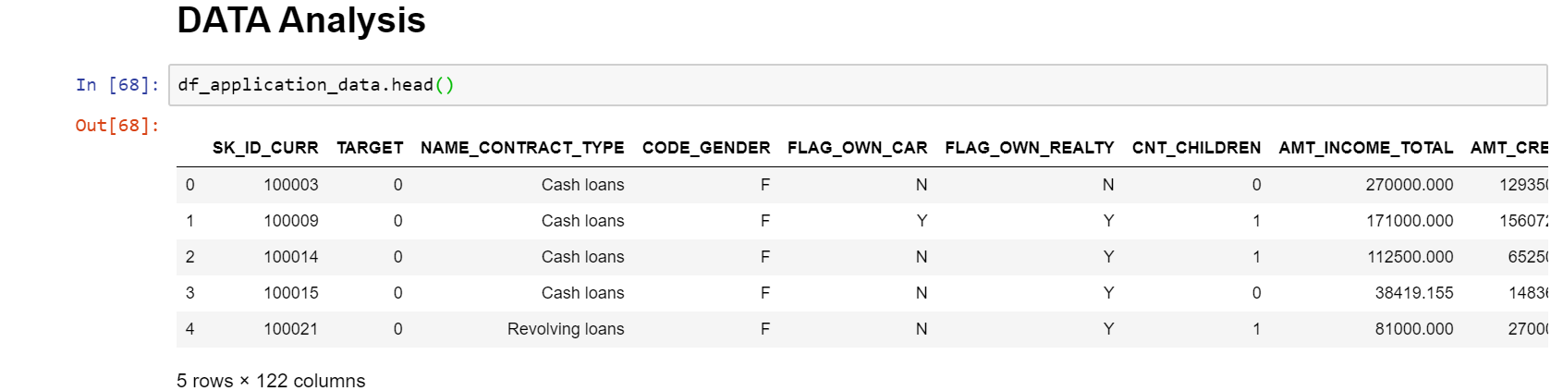
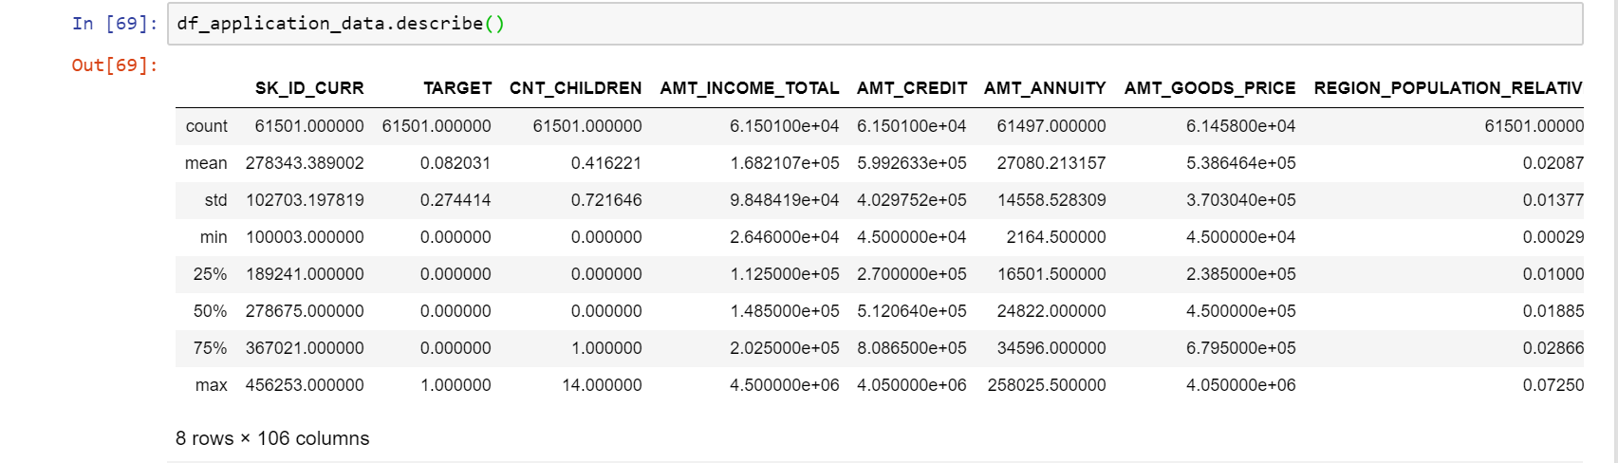
Sampling of data to find out data definitions
As given data set is quite large for Analysis. We have taken only 30% of the data for our analysis. This will help us to speed up the data analysis with minimal memory consumption.
Application_data.csv has all the data related the Loan Applicant

Slide 9
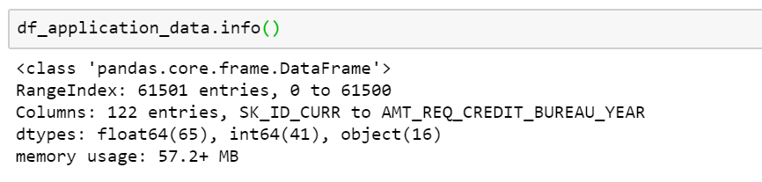
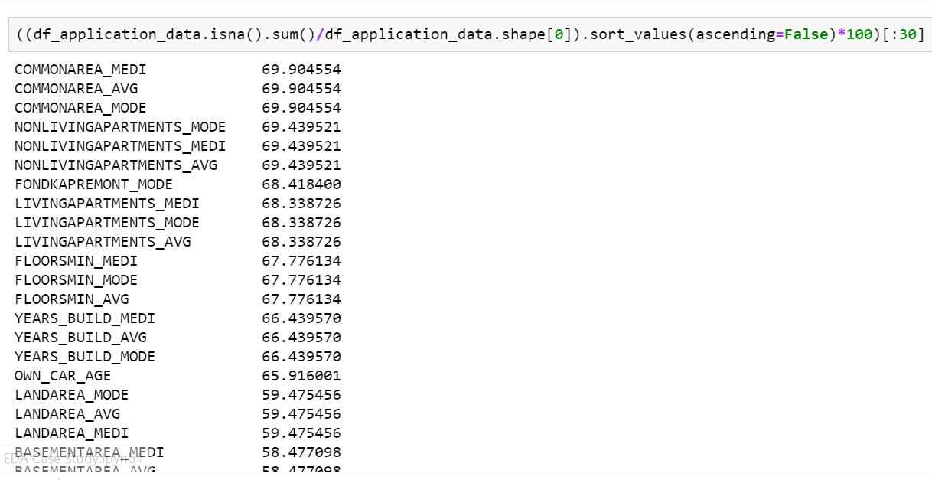
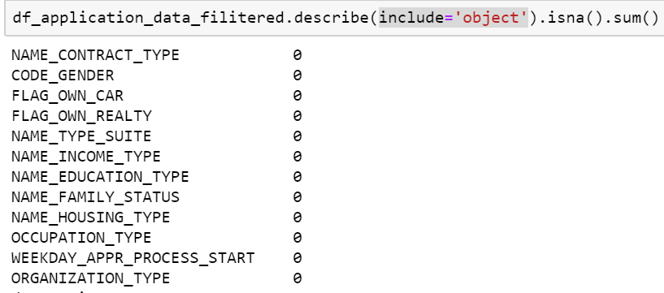
Understanding the various Features of data
Analyzing the data types of al the columns.
Finding NULL values in each Feature
Finding NULL values For categorical variable

Slide 10
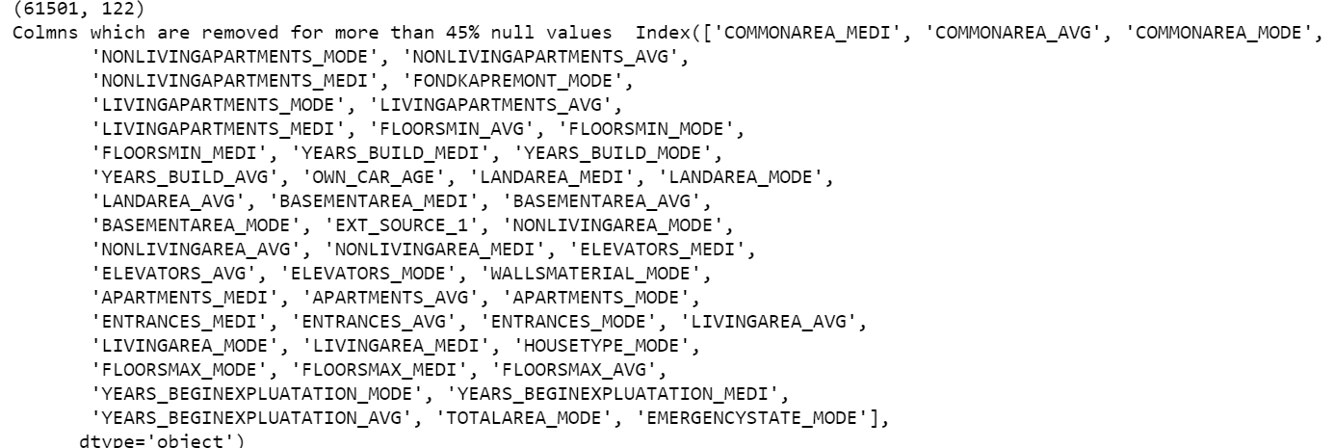
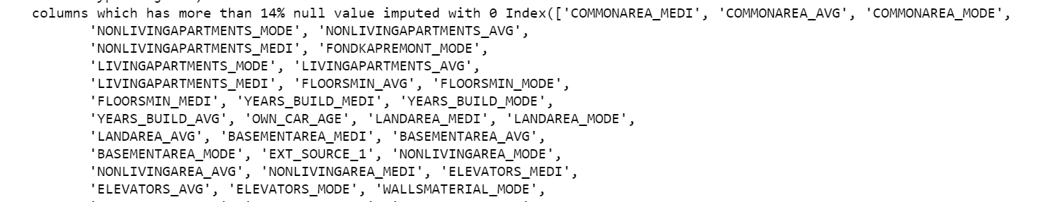
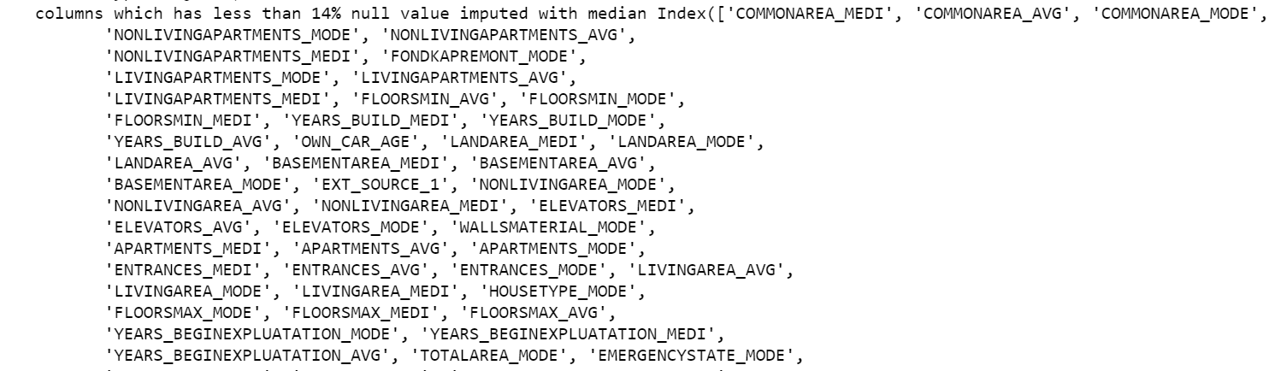
Data Cleaning :
As mentioned in the requirement we have removed the columns which has null value percentage more than 45% and we have umpute the variables with zero which has null value more than 14% and again the variables which has less than 14% null value we have imputed with median for numerical variable.
For categorical variables the null value should be imputed with mode value of the respective column but we did not find any null value in the categorical variable.

Slide 11
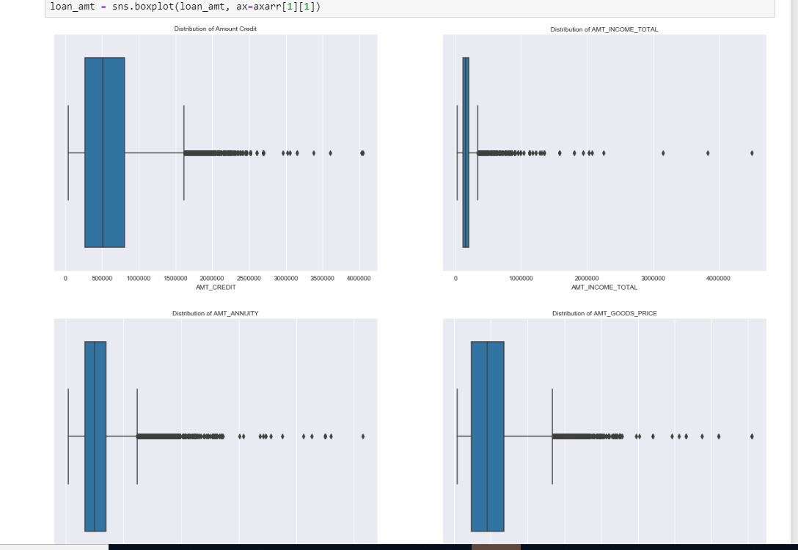
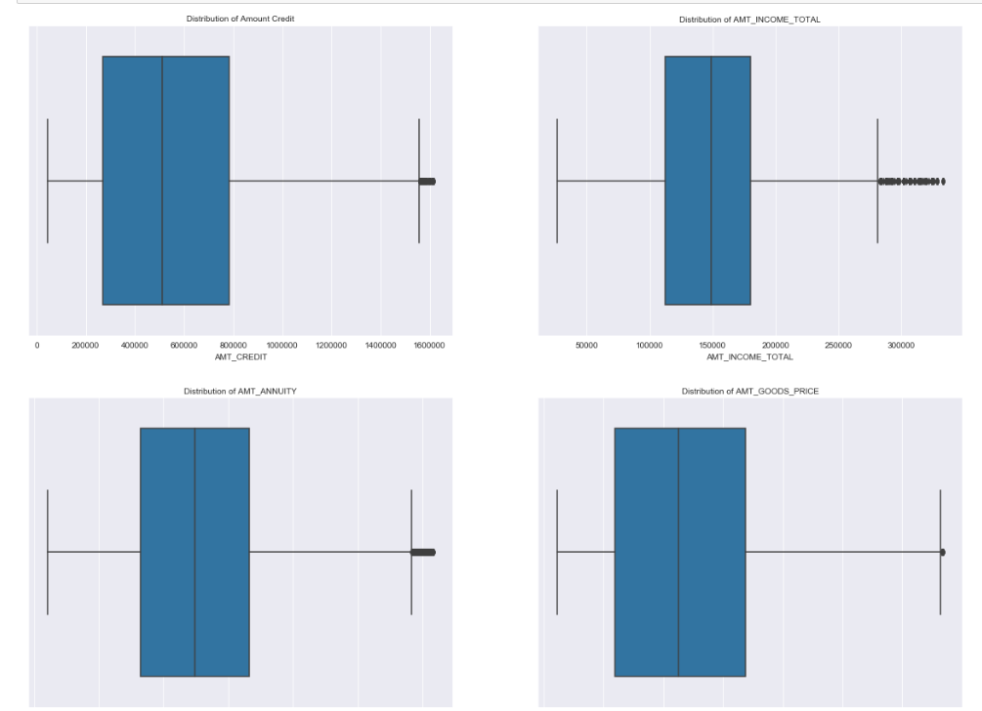
Univariate Analysis : Outlier Analysis
Finding out the Outliers in Univariate variables
After imputing of Outliers from Univariate variables

Slide 12
Univariate Analysis : Continuous Variables
We have identified following numerical variable Univariate Continuous Variable analysis
AMT_CREDIT
AMT_INCOME_TOTAL
AMT_ANNUITY
AMT_GOODS_PRICE

Slide 13
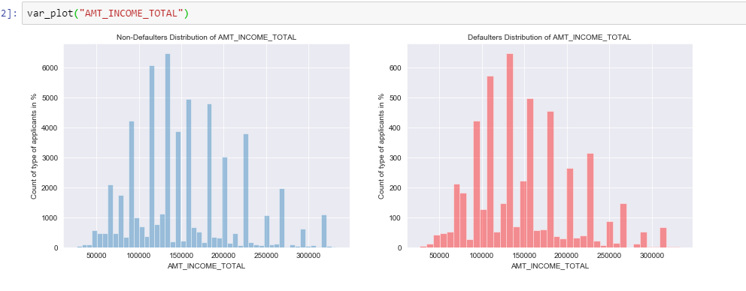
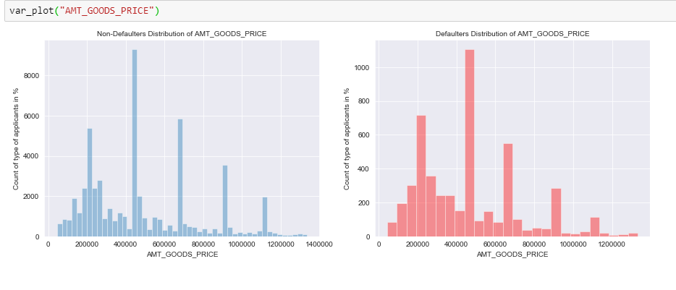
Univariate Analysis : Amount Income Total
Univariate Analysis : Amount Goods Price
People with high income are repaying the loans and people who have taken high amount loan are also repaying the loan

Slide 14
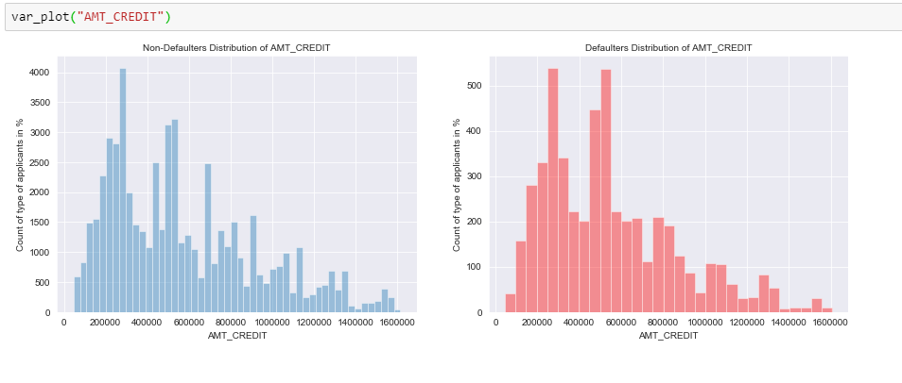
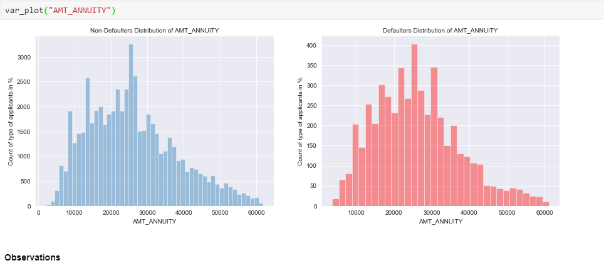
Univariate Analysis : Amount Credit
Univariate Analysis : Amount Annuity
People with amount credit more than 1600000 are repaying the loans in most of the cases

Slide 15
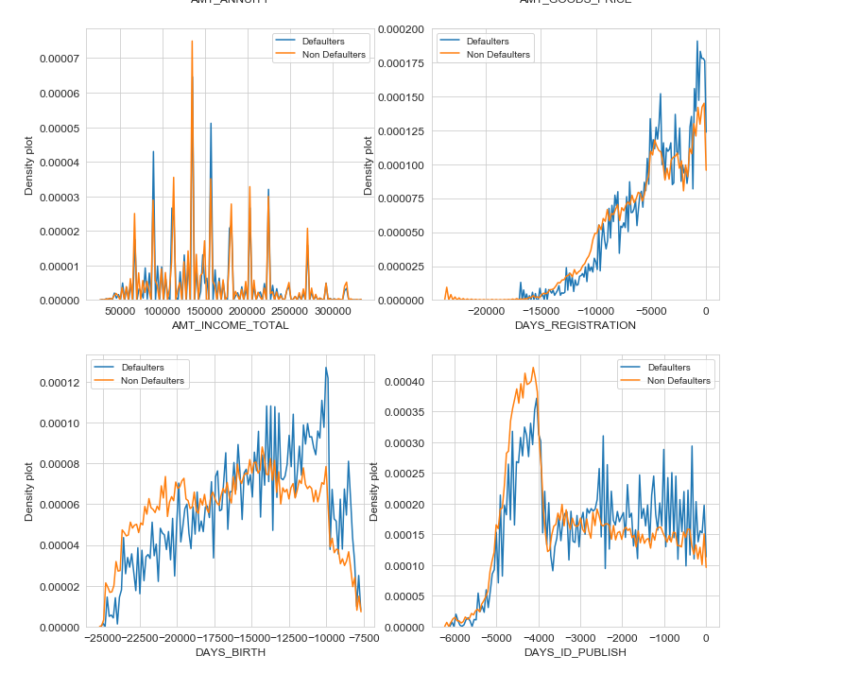
Persons with age between 30 years and 50 years has high number of defaulter.
person with id changed in last 1000 days of application has high number of defaulters

Slide 16
Categorical Variable Analysis
We have identified following variable as Categorical Variable for analysis:
NAME_EDUCATION_TYPE
NAME_INCOME_TYPE
NAME_CONTRACT_STATUS
NAME_FAMILY_STATUS

Slide 17
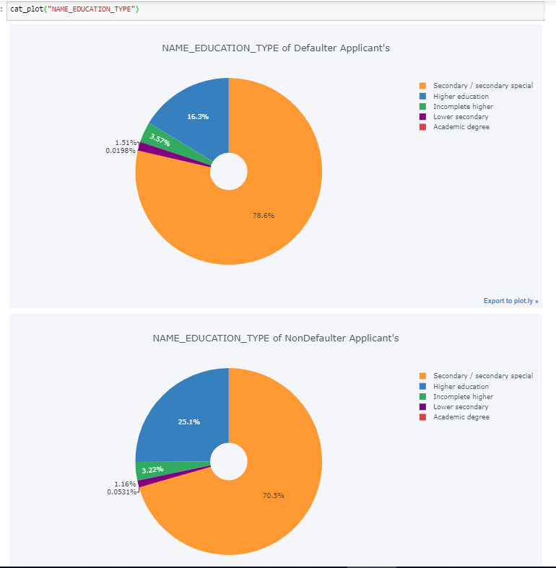
Categorical Variable: Education Type
With Education Type categorical variable use we can identify what are % of different Education types are Defaulters or Non-Defaulters.
Close to 16% out of total defaulters are Higher educated, however most of the defaulter are lies in Secondary Education.

Slide 18
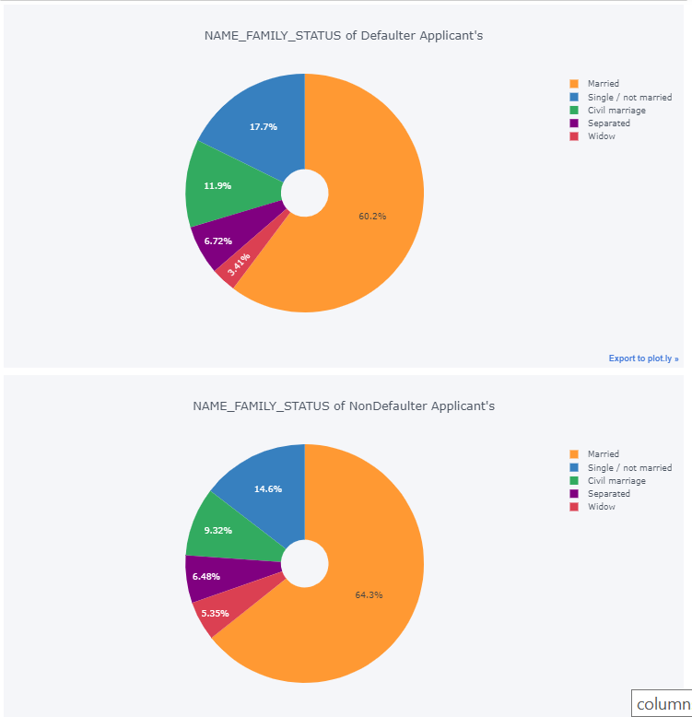
Categorical Variable: Family Status
With Family status categorical variable use we can identify what are % of different family status are Defaulters or Non-Defaulters.
Widows are more likely to repay the loan when compared to appliants with the other family statuses

Slide 19
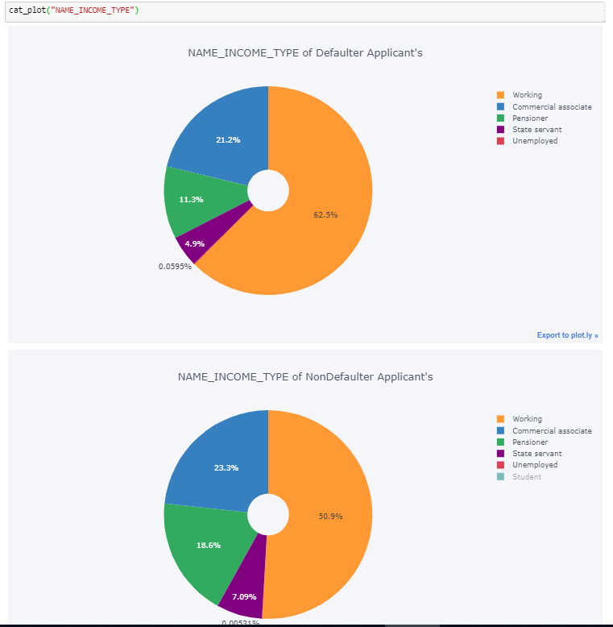
Categorical Variable: Income type
With income type categorical variable use we can identify what are % of different income type are Defaulters or Non-Defaulters.
From the above plot we can conclude that All the Students and Businessman are repaying loan.

Slide 20
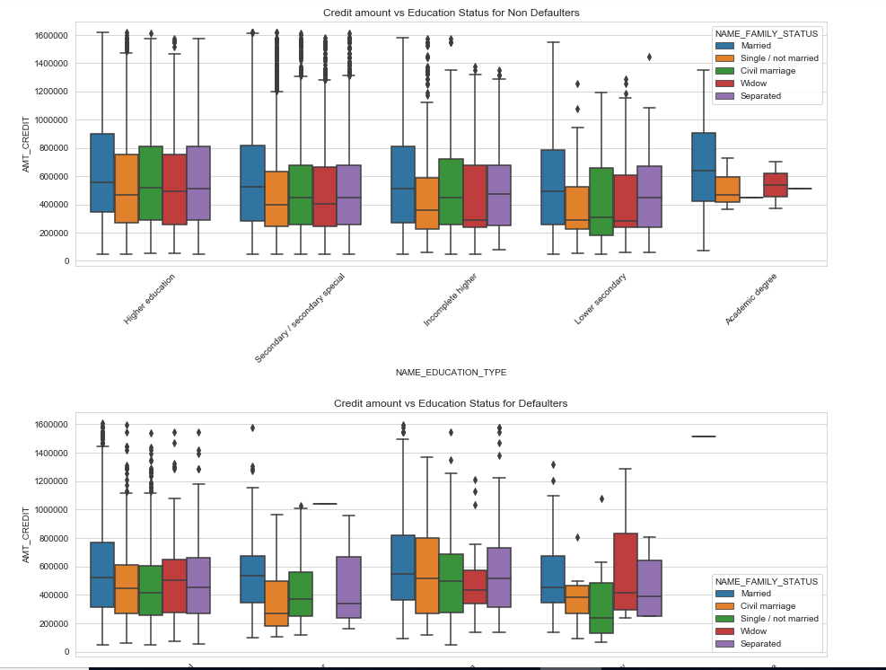
Bivariate Variable Analysis
Credit amount vs education status
for non defaulters, Academic degree education with Family status of 'civil marriage', 'marriage' and 'separated' of are having higher number of credits than others.
Also, higher education with family status of 'marriage', 'single' and 'civil marriage' are having more outliers.
For defaulters having higher education with Family status of 'civil marriage', 'marriage' and 'separated' are having higher number of credits than others.

Slide 21
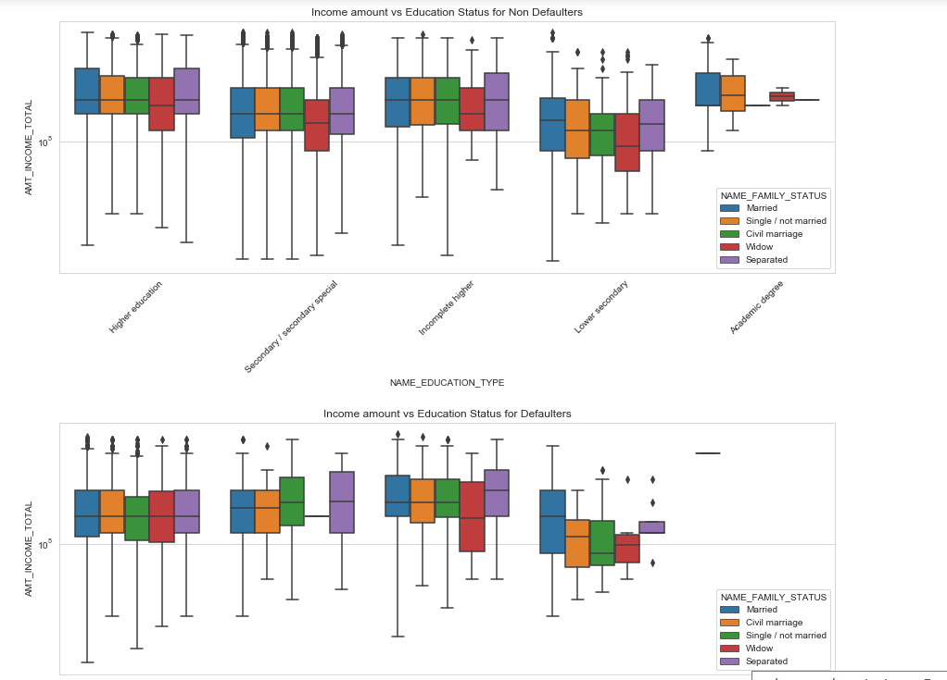
Bivariate Variable Analysis
Income total vs education status
Persons with 'Higher education', the income amount is mostly equal for all the family status.
Lower secondary are having less income amount than others.

Slide 22
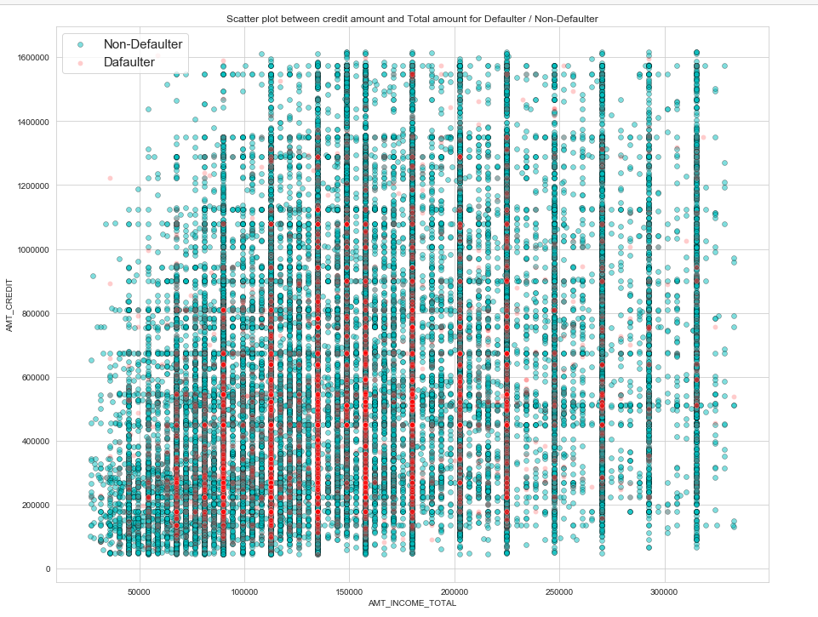
Bivariate Variable Analysis
Income total vs Amount credit
loan amount between 20000 and 100000 and total income between 10000 to 25000 has most of the defaulter list

Slide 23
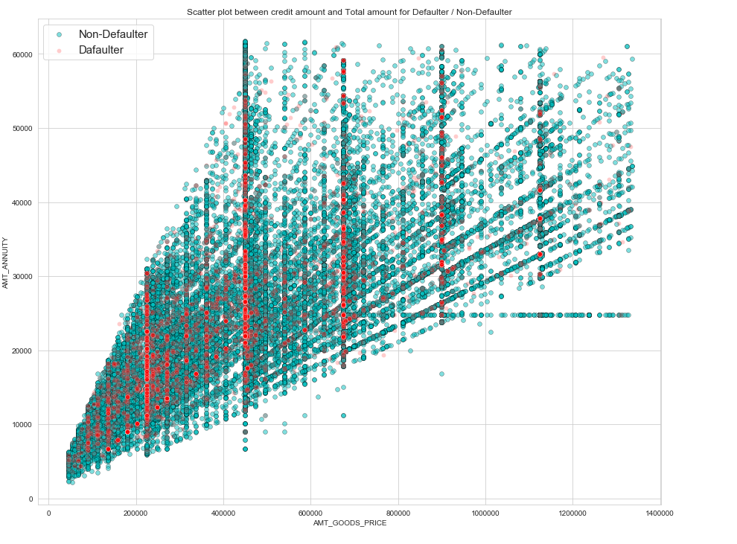
Bivariate Variable Analysis
Amount goods price vs amount annuity
Amount goods price between 400000 and 800000 and amount annuity between 10000 and 40000 we have max no of defaulters

Slide 24
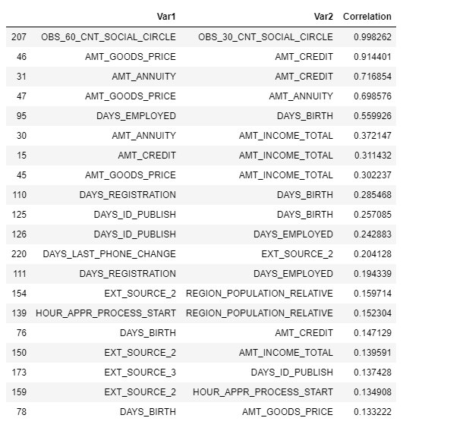
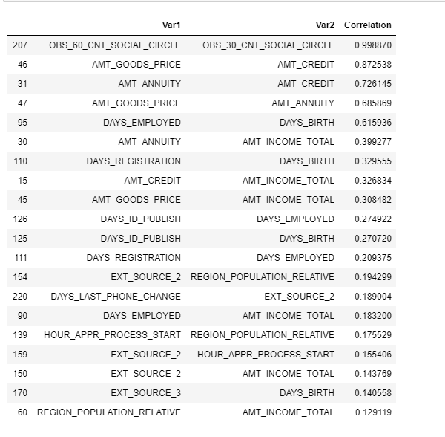
Finding the correlation between continuous variables
correlation between continuous variables For defaulters
correlation between continuous variables
For Non defaulters

Slide 25
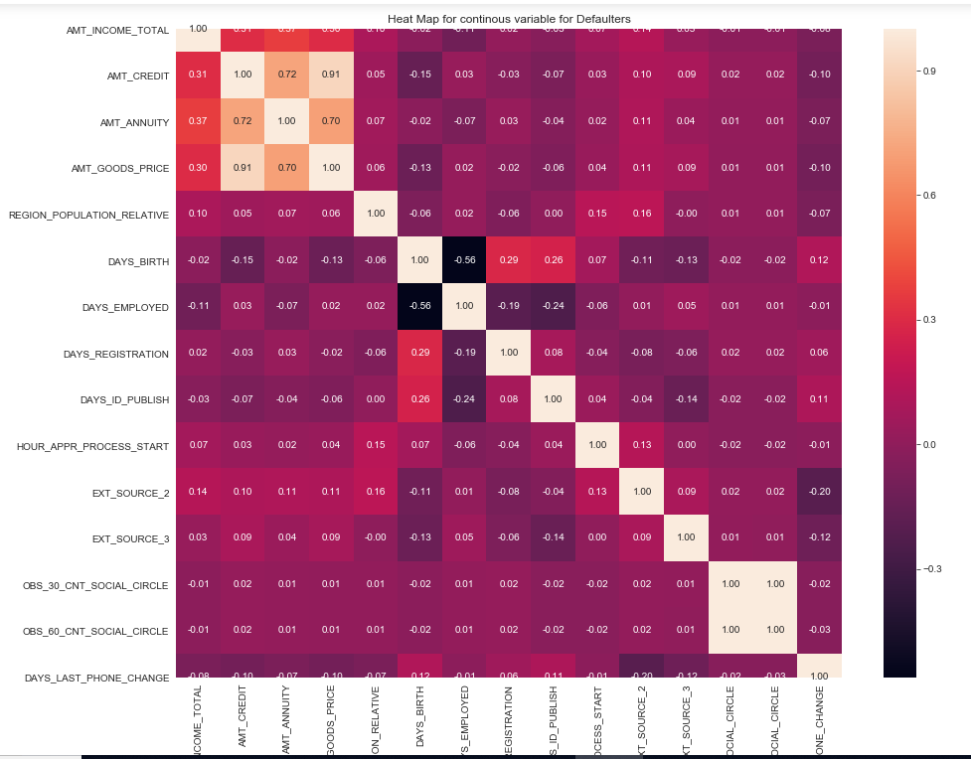
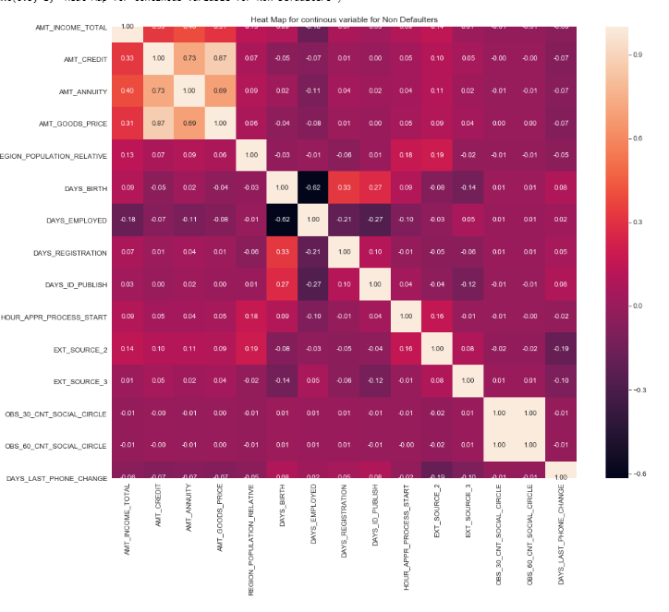
Finding the correlation between continuous variables
correlation between continuous variables For defaulters
correlation between continuous variables
For Non defaulters

Slide 26
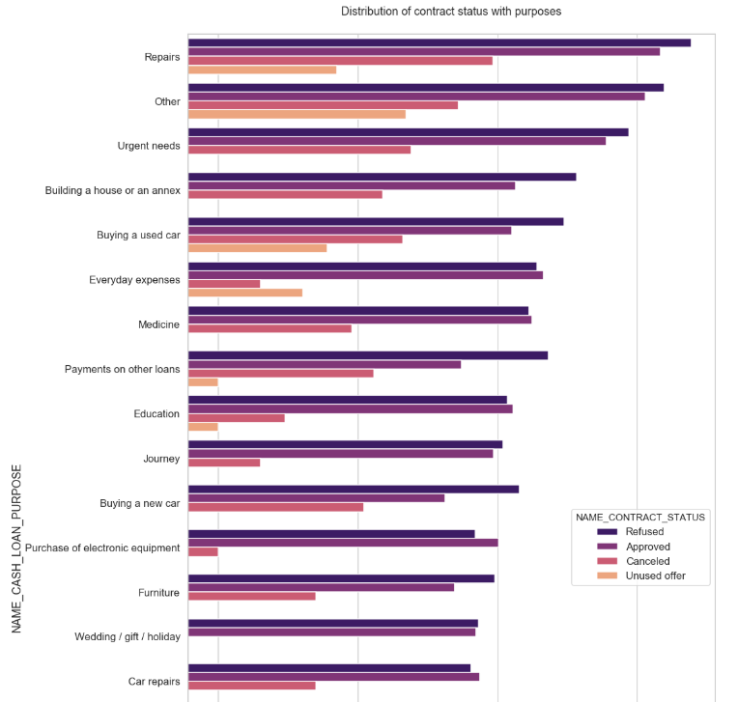
contract status with purposes in logarithmic scale
Categorical Variable: Previous loan Application Status
Loan taken fr purpose of repair has highest no of rejection
For education purposes we have almost equal number of approves and rejection
loan taken for the purpose of "Payign other loans" and "buying a new car" is having significant higher rejection than approves

Slide 27
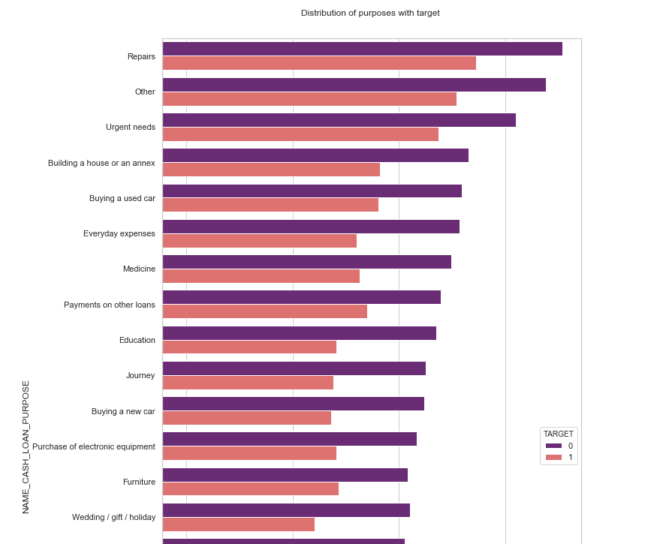
Distribution of contract status with Taget
Categorical Variable: Previous loan Application Status
Loan taken for the purpose of 'Repairs' are most of te defaulters.
Loan taken for the purpoese of 'Buying a garage', 'Business developemt', 'Buying land','Buying a new car' and 'Education' are most of the defaulters.
Hence we can focus on these purposes for which the client is having for minimal payment difficulties.

Slide 28
Findings From The Analysis
People who are taking large amount of loan are likely to repay the loan
Persons with age between 30 years and 50 years has high number of defaulter.
person with id changed in 1000 days of application has high number of defaulters.
From the above plot we can conclude that All the Students and Businessman are repaying loan.
Widows are more likely to repay the loan when compared to appliants with the other family statuses.
People with Academic Degree are more likely to repay the loan only 0.0198% have not repayed the loan.
The focus of the bank should be more on contract type ‘Student’ ,’pensioner’ and ‘Businessman’ with housing ‘type other than ‘Co-op apartment’ for successful payments.
The focus of the bank should be less on income type ‘Working’ as they are having most number of unsuccessful payments.
Loan taken for the purpose ‘Repair’ is having higher number of unsuccessful payments on time.

